Slide 1
Ganaway Residential Trip
Parents’ Information Session
24th March, 2022

Slide 2
Basic Information
Dates
Leave school on Monday 23rd May @ 9am
Return to school on Wednesday 25th May by 3pm
Cost
£150 to be paid via ParentPay in full by Friday 6th May
£10 deposit will hold a place
Venue
Ganaway Activity Centre in Millisle
Staffing
Miss Lindsay – teacher in charge
2 or 3 other members of staff depending on pupil numbers
Pupils
40 child spaces (depending on gender split may be less)
Priority given to Primary 7 children, during week 1 (5th April) then open to Primary 6 (8th April at 2pm)

Slide 3
Where is Ganaway?

Slide 4
Ganaway Activity Centre
Ganaway clip (please click on the link below)
https://www.youtube.com/watch?v=X6LqyLRLiJk
Accommodation
We will be staying in the Millennium Centre
Rooms are between 2 and 6 bunks
Children are responsible for cleaning their room and making their bed
Meals are provided
– see the menu later in the presentation
Transport
will be by private hire bus
Facilities and activities
are all included in the price and are detailed later on in the presentation

Slide 5
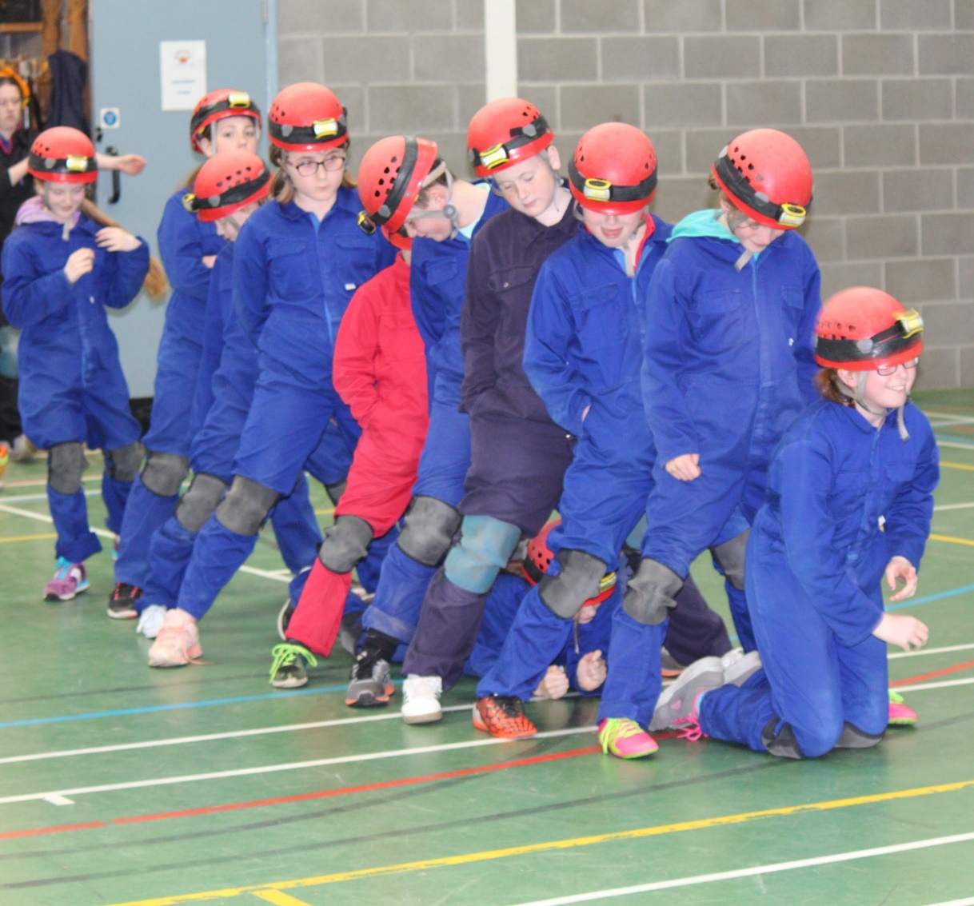
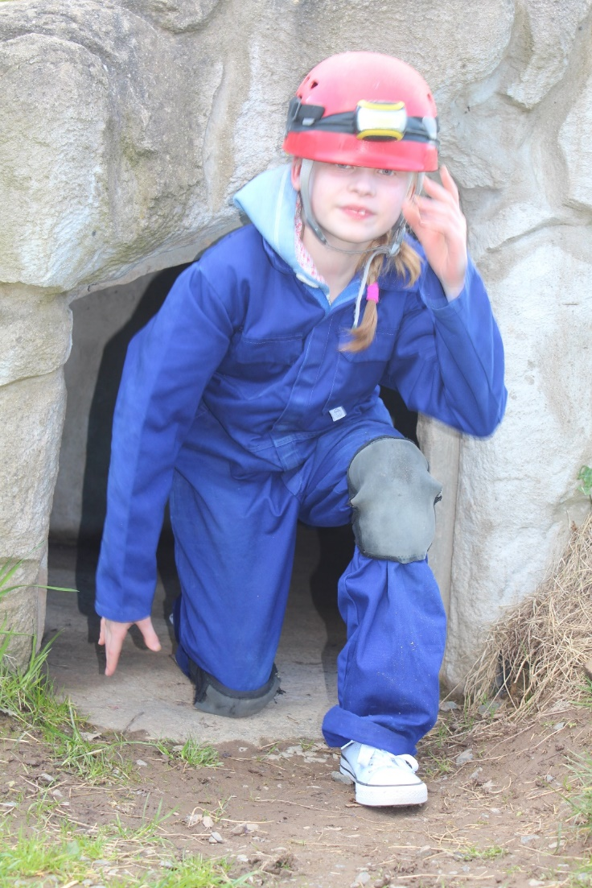
Caving

Slide 6
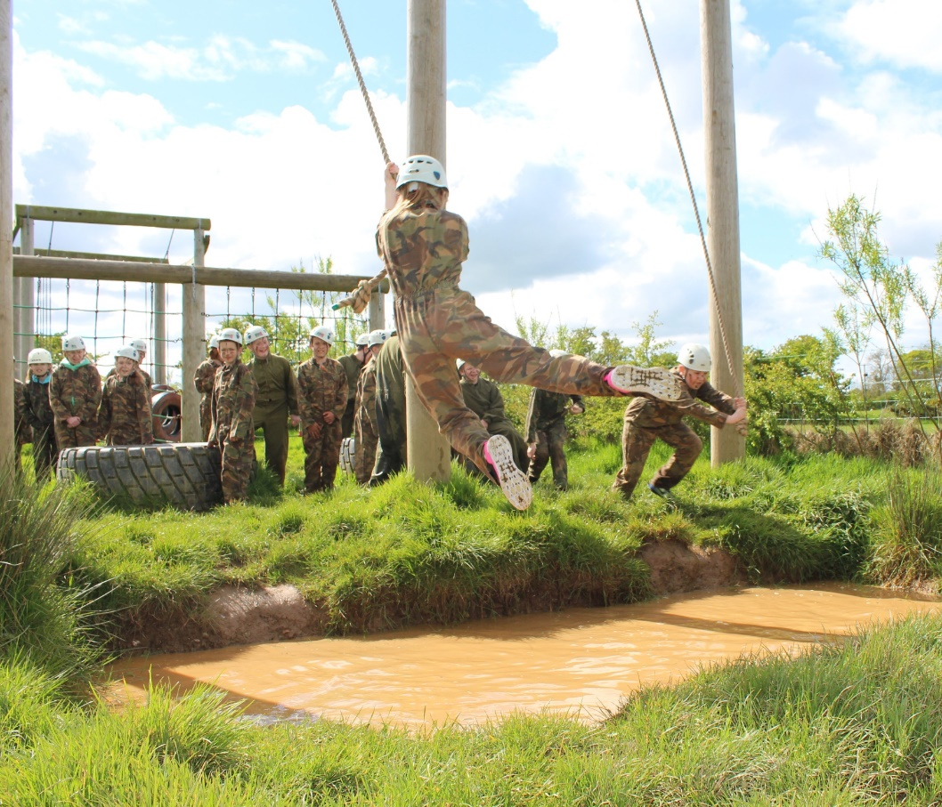
Assault Course

Slide 7
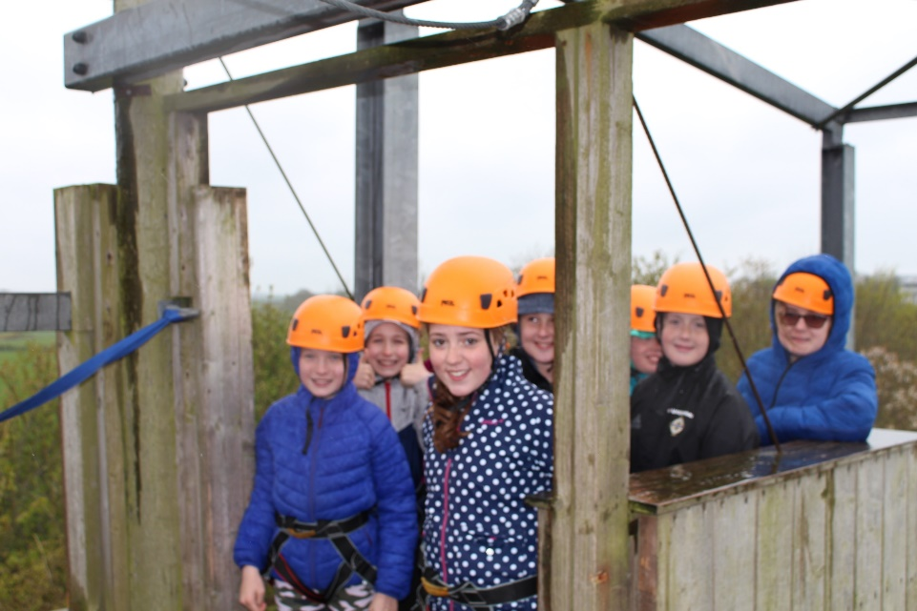
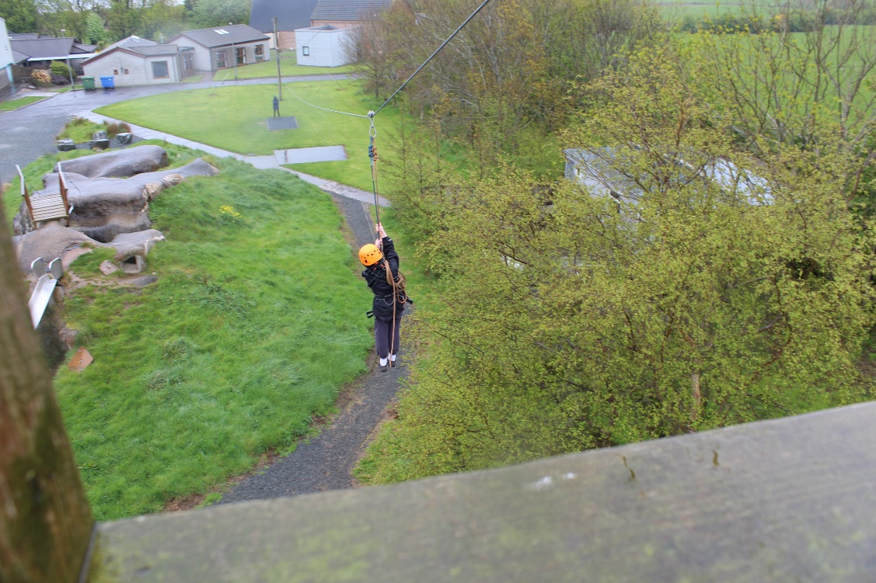
Zipline

Slide 8
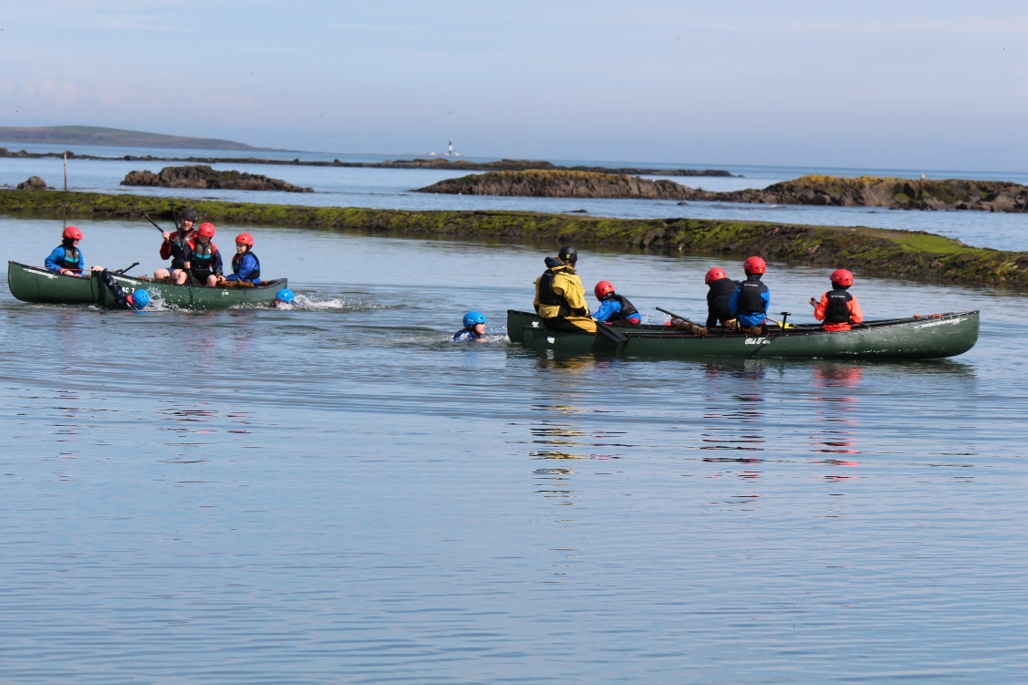
Canoeing

Slide 9
Beach Walks

Slide 10
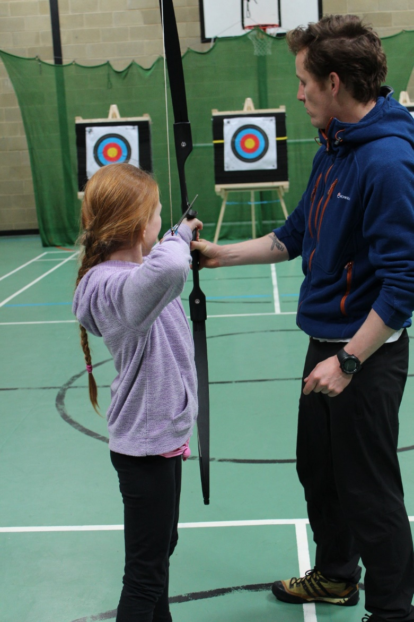
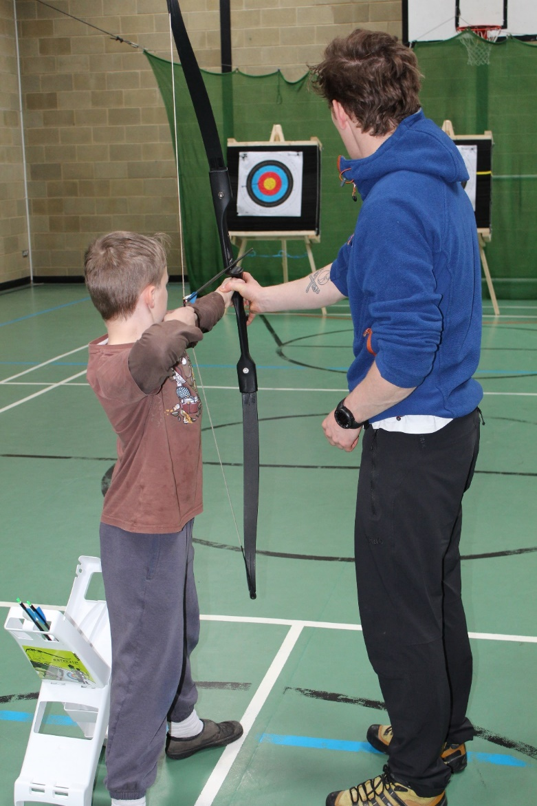
Archery

Slide 11
Camp Fire

Slide 12
Requirements
Suggested clothing list
No mobile phones or electronic equipment
Updates on school facebook page, website and email
Medication
May be taken but there will be forms for completion and all medication must be given to staff who will supervise self administration
Packed lunch for first day
Sweet treats are permitted on the trip but NO energy drinks

Slide 13
Suggested Itinerary and meals
Day | Monday | Tuesday | Wednesday
BREAKFAST 9.00am-9.30am | GAC to Collect at Clare PS @9am. Arrival@11am. Move into accommodation. | Cereal, Toast, juice and Ulster Fry | Cereal, Toast, juice and Scrambled eggs and Bacon | NOTES – Teachers to arrange main group into three groups of 13 on Monday morning.
Session 1 10.30am-12.30pm | Group 1 – Canoeing Group 2 – Zipline/Archery Group 3 - Caving | 10.00am-12.00pm Group 1 - Zipline/Archery Group 2 – Caving Group 3 - Canoeing | 10.00am-12.00pm Group 2 – Climbing Wall/Orienteering Group 1 – High Ropes/Low Ropes
LUNCH 1.00-1.30pm | Soup and Sandwiches. Fruit and yogurt. | Chicken Korma or Sweet & Sour with Rice. Fruit and yogurt | 12.30pm-1.00pm Pizza and potato spirals. Fruit and yogurt.
Session 2 2pm-4pm | Group 1 - Caving Group 2 – Canoeing Group 3 - Zipline/Archery | Group 1 – Climbing Wall/Orienteering Group 2 – High Ropes/Low Ropes | Tidy up accommodation and Depart 1.45pm
DINNER 5.00-5.30pm | Chicken Goujons, chips and Beans. Chocolate and cream. | Pork and leek sausages with champ and onion gravy. Ice cream
Session 3 6.00pm-7.00pm | Scavanger Hunt – Instructor led | All Groups Camp Fire (Norman)
SUPPER | Bread and Jams | Bread and Jams

Slide 14
Details and Medical
Leaving School 9.00 am Monday 23rd May 2022
Returning to school 3pm Wednesday 25th May 2022
Emergency Contact In an emergency please contact
Miss Lindsay at Ganaway Activity Centre Tel. 028 9186 1297
Medicines Please note, written instructions for giving medicines should be
given to the teacher on the morning of departure, together with the medicine
Date
Time
Child’s Name
Medicine/Tablets Taken
Present
Signed
Signed

Slide 15
Medical & Consent form
Child’s Name _______________ Date of Birth _____________________
Address ___________________________________________________________________________
________________________________________________ Telephone No ______________________
Family Doctor _______________________________ Nat. Health No __________________________
If your child is currently on medication, please detail below and discuss with one of the teachers in charge.
__________________________________________________________________________________
__________________________________________________________________________________
* Label all medicines clearly with child’s name and dosage and give to child’s teacher on day of departure.
In the event of an emergency I authorise the teacher-in-charge to give permission for any medication or treatment which might be necessary.
I also give my formal permission for my child to go on the trip and to participate in all planned activities.
Signed: ________________________________________ Parent/Guardian
Other Relevant Information ____________________________________________________________
__________________________________________________________________________________

Slide 16
Clothing List All specialist equipment will be provided by the centre eg wetsuits.
You are required to bring:-
A light anorak
2/3 warm jumpers, sweatshirts
2/3 Tracksuit bottoms (jeans can be worn in the centre but are unsuitable for outdoor activities)
4 or 5 pairs of socks – include a thick pair if possible
2 pairs of trainers - 1 old pair for getting wet
slippers or something to wear on feet around the centre in the evening
pyjamas
3 or 4 T-shirts
changes of underwear
woolly hat/baseball cap,
2 bath towels
Swimsuit or trunks
wash kit
1 pairs of shorts
suntan lotion (for sun and wind burn)
camera (optional)
torch (optional)
3 plastic bags (to bring home wet gear)
Please ensure all clothing is clearly labelled with child’s name.
All activities take place outside so it is recommended not to bring
‘good’ or ‘new’ clothes
A sleeping bag is not required
Children do not need pocket money
Please no mobile phones

Slide 17
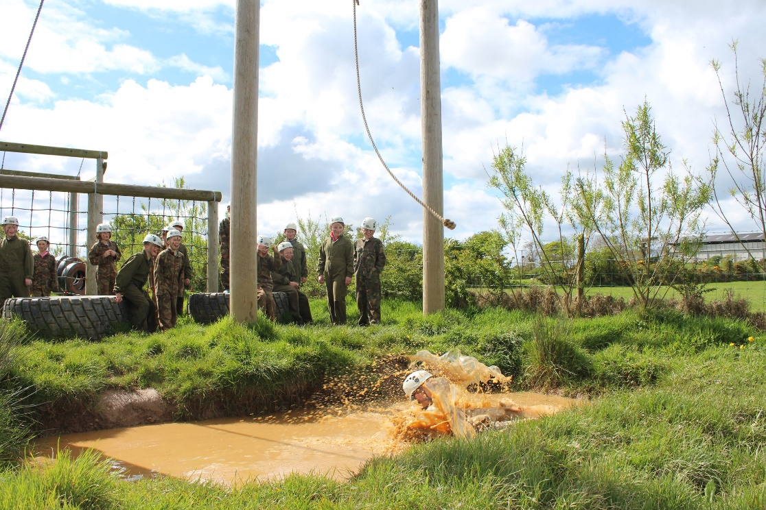
Please do not buy new clothes for this trip…

Slide 18
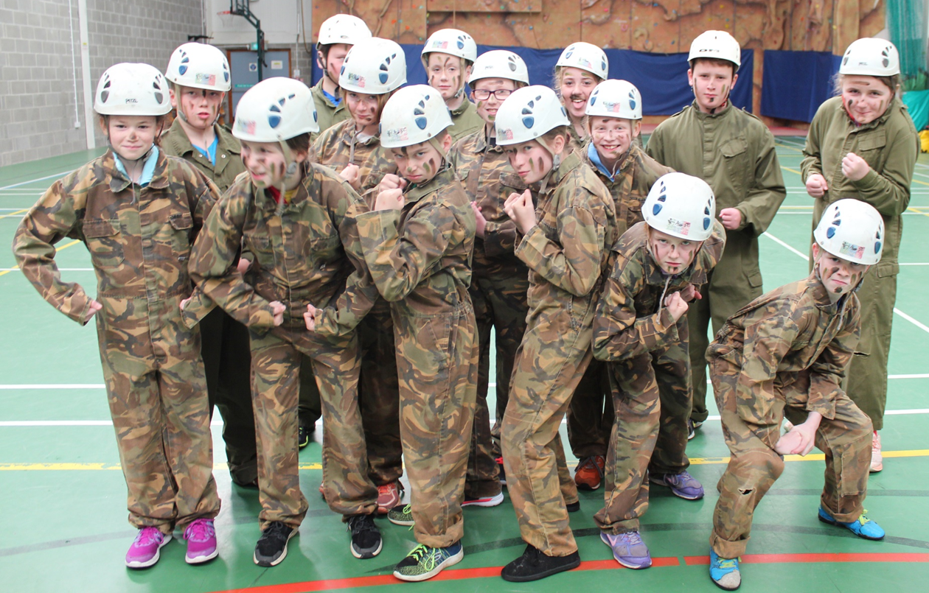
Benefits of the trip:
Team building
Confidence
Independence
Self esteem
Self confidence
Friendship development
Problem solving

Slide 19
Questions Please email slindsay313@c2ken.net

